Slide 1

Lamis Mansour
Oct 2020

Slide 2
El Patrón
A platform for managing order’s deliveries and pickups
The demand for working with deliveries has increased especially during Covid-19 and the main purpose of the web application is to make it simple and fast
The end user can order drinks using the web application and choose the delivery method

Slide 3
Programming Languages and Technology
Vanilla JS Framework – for creating the files and settings needed for the project.
Webpack Library build tool - for building the bundle.js file
HTML, CSS , JavaScript and Jquery
Json-Server – for mocking REST API calls from client to server
http-server – for connecting the server with the browser

Slide 4
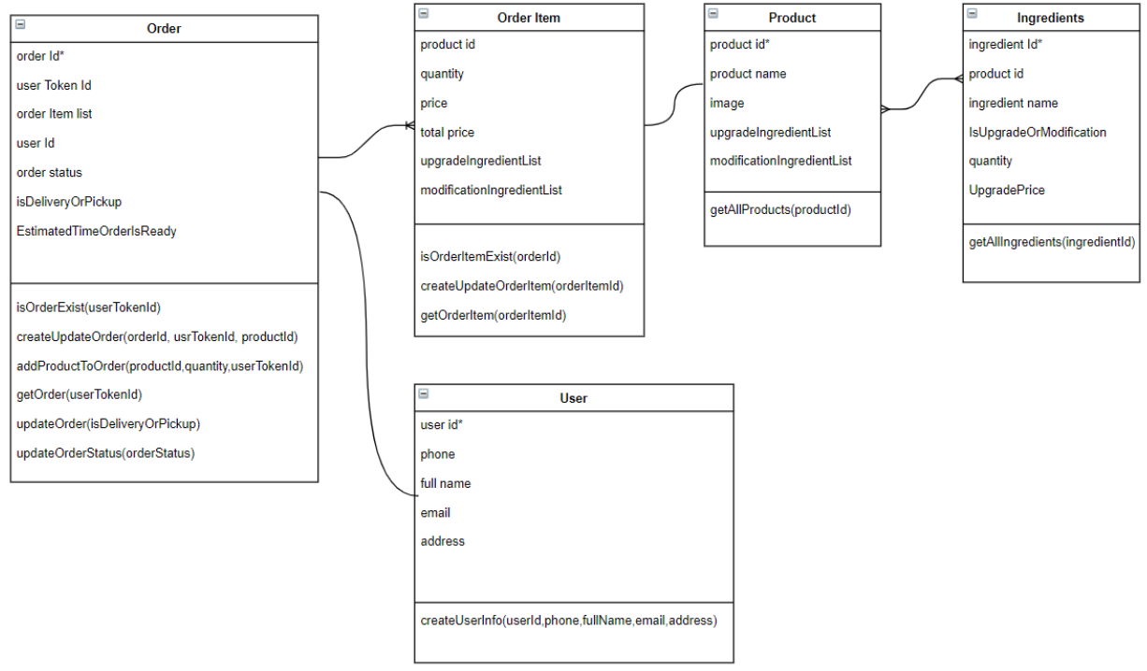
Components and Functions

Slide 5
Building the project
HTML files and JS files for creating the web pages
Service.js file includes all the methods that are called from js files and provide the necessary information by using Ajax Jquery calls to the server.
Server.js file includes the json-server settings and custom rest API calls for the mock
db.json - JSON database file used by the mock

Slide 6
Other Services and plugins
JQuery-Mustache Plugin to create HTML templates
to create the menu page and the cart page
takes two parameters: the html template as string and the data object and mustache.render function renders the needed data repetitively to the page.
Browser SessionStorage and localStorage
to save the products list in the browser and prevent repeated calls to the server
to save the UserTokenId in the browser for only one session. Once the user orders the first item a unique userTokenId is created for the user

Slide 7
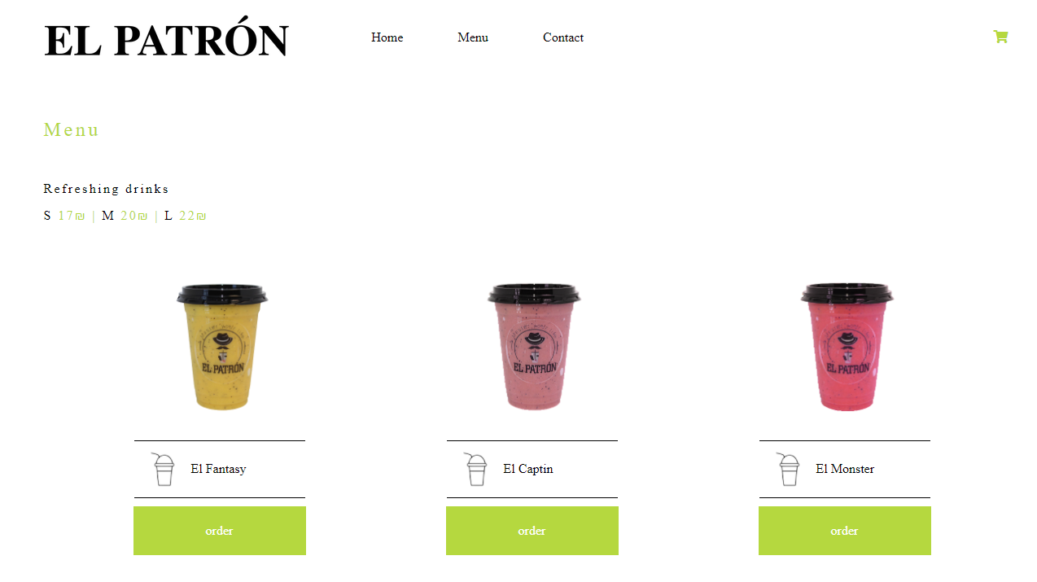
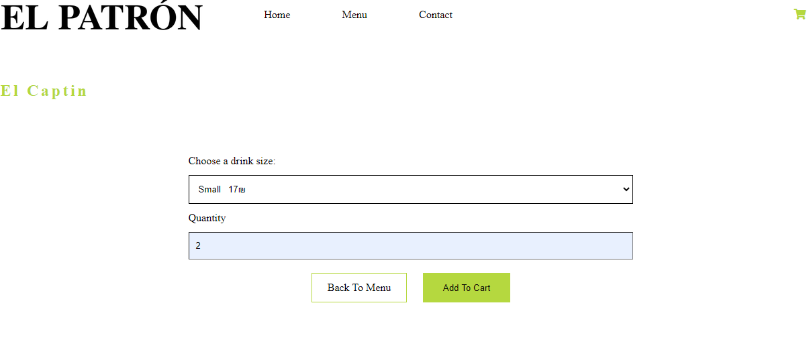
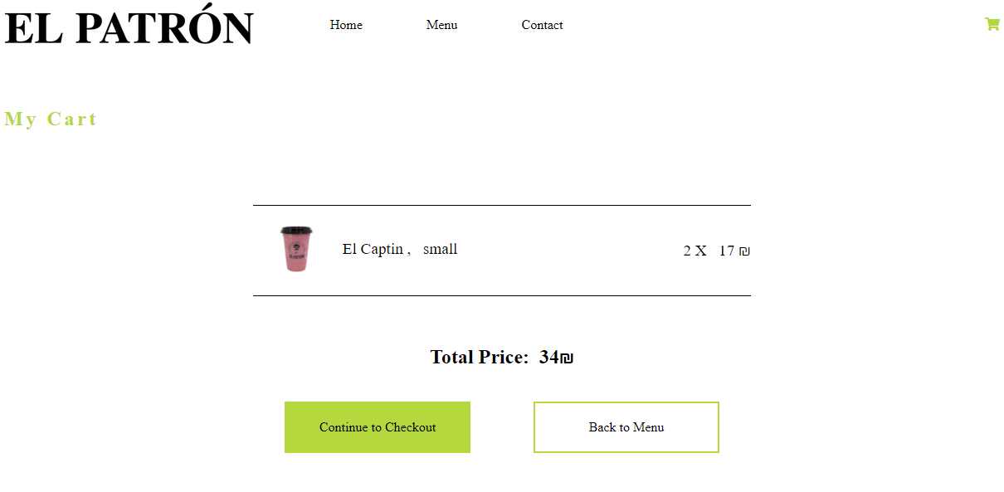

Slide 8
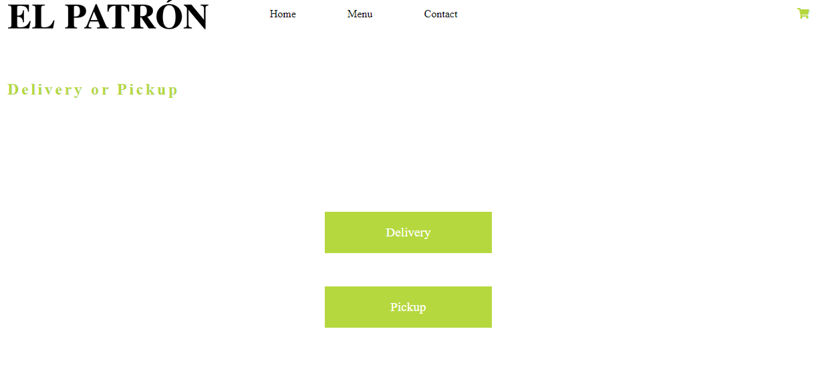
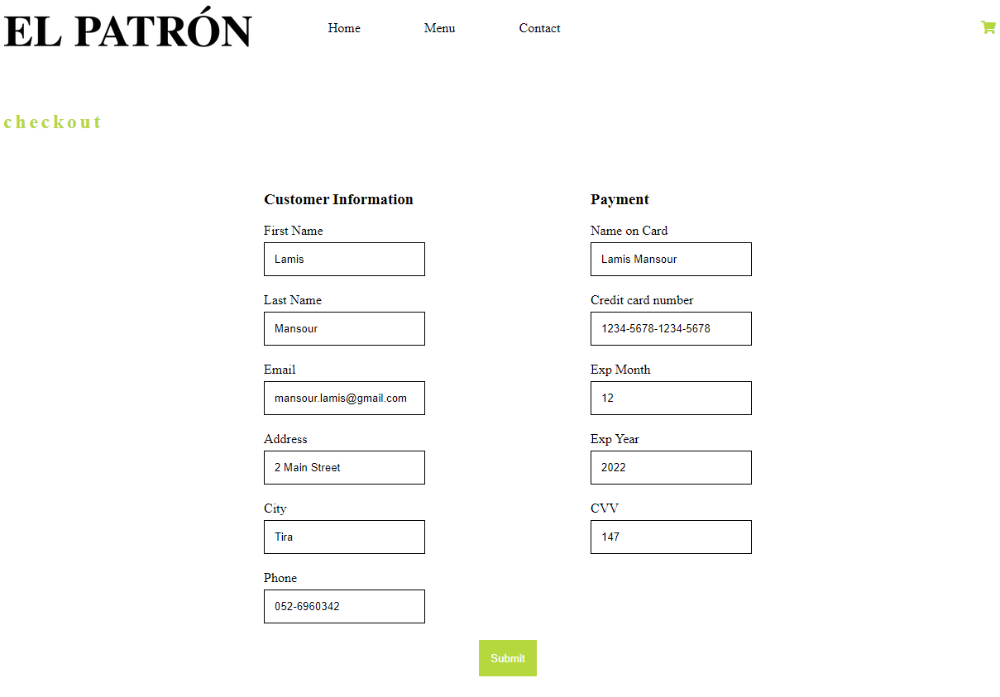
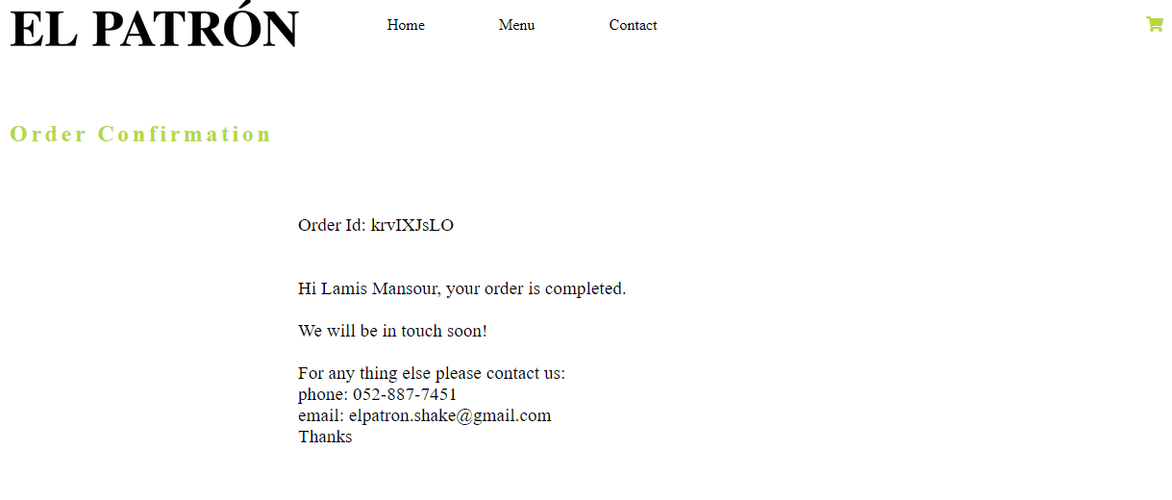

Slide 9
Next Steps
Ingredients - add the option for the customer to add/remove ingredients as he desires.
Payment process - interference with a third party in order to complete the payment process
Estimated delivery time calculation and implementation
Send the order confirmation to the client and business by e-mail
Implement responsive design with Mobile
Unit testing

Slide 10

Thank You

